Slide 1

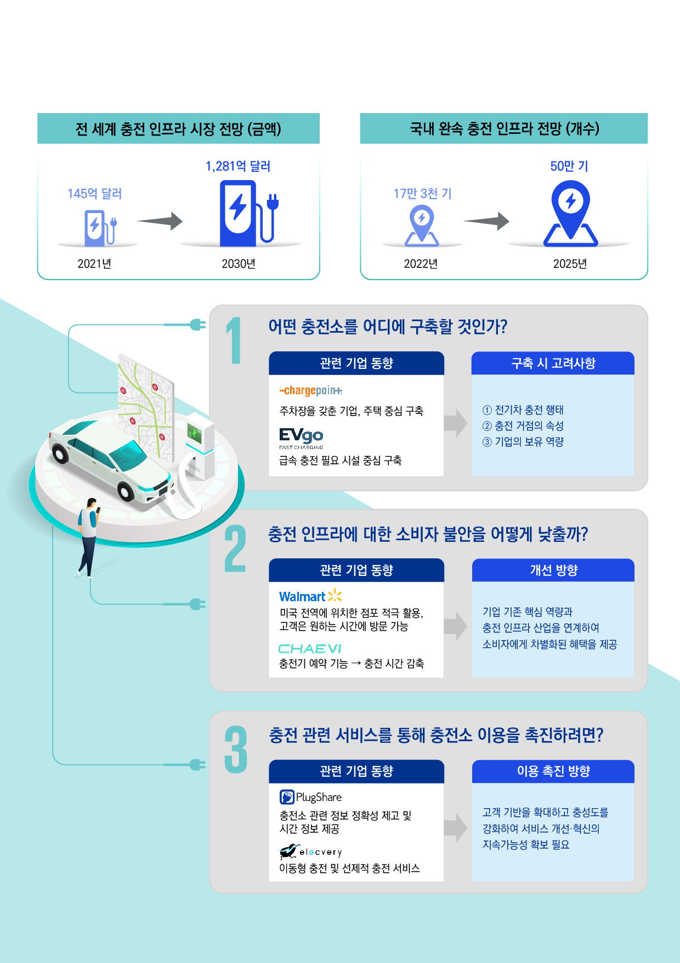

충전 산업의 부상,
시장 선점을 위한 3가지 질문
© 2023 KPMG Samjong Accounting Corp., a Korea Limited Liability Company and a member firm of the KPMG global organization of independent member firms affiliated with KPMG International Limited, a private English company limited by guarantee. All rights reserved.

